Slide 1
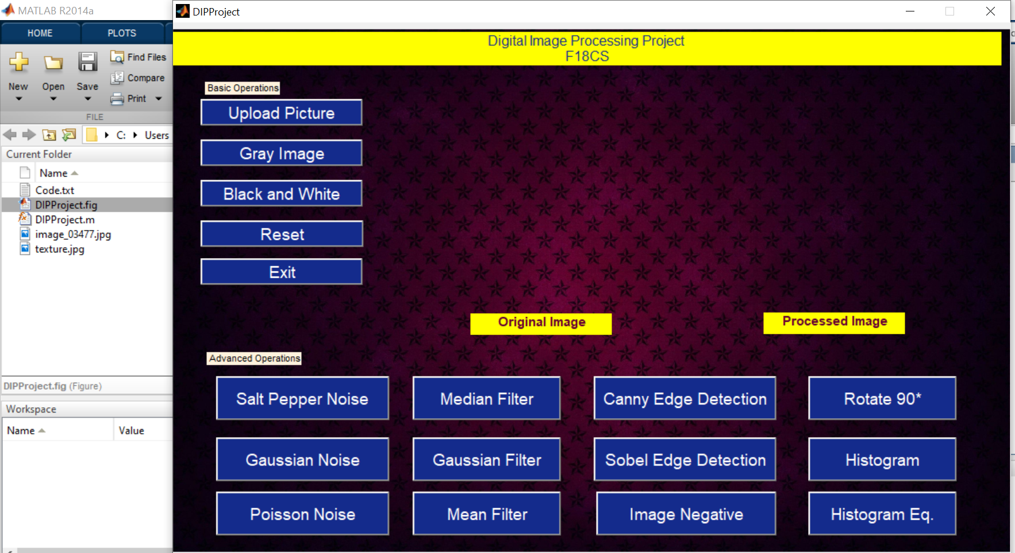
StartUp

Slide 2
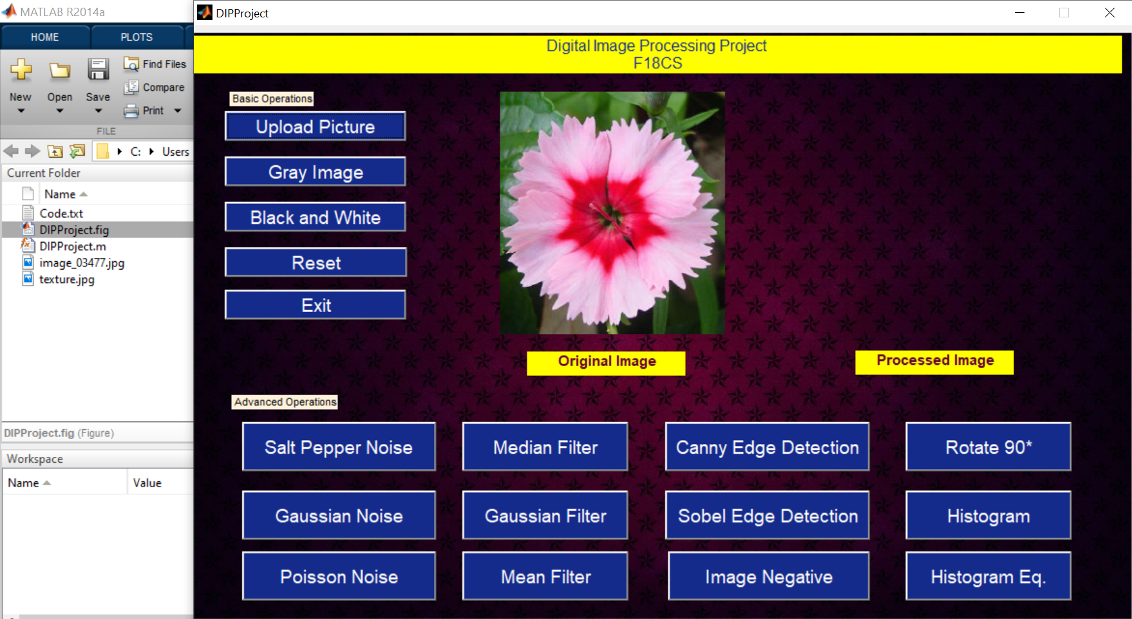
Upload

Slide 3
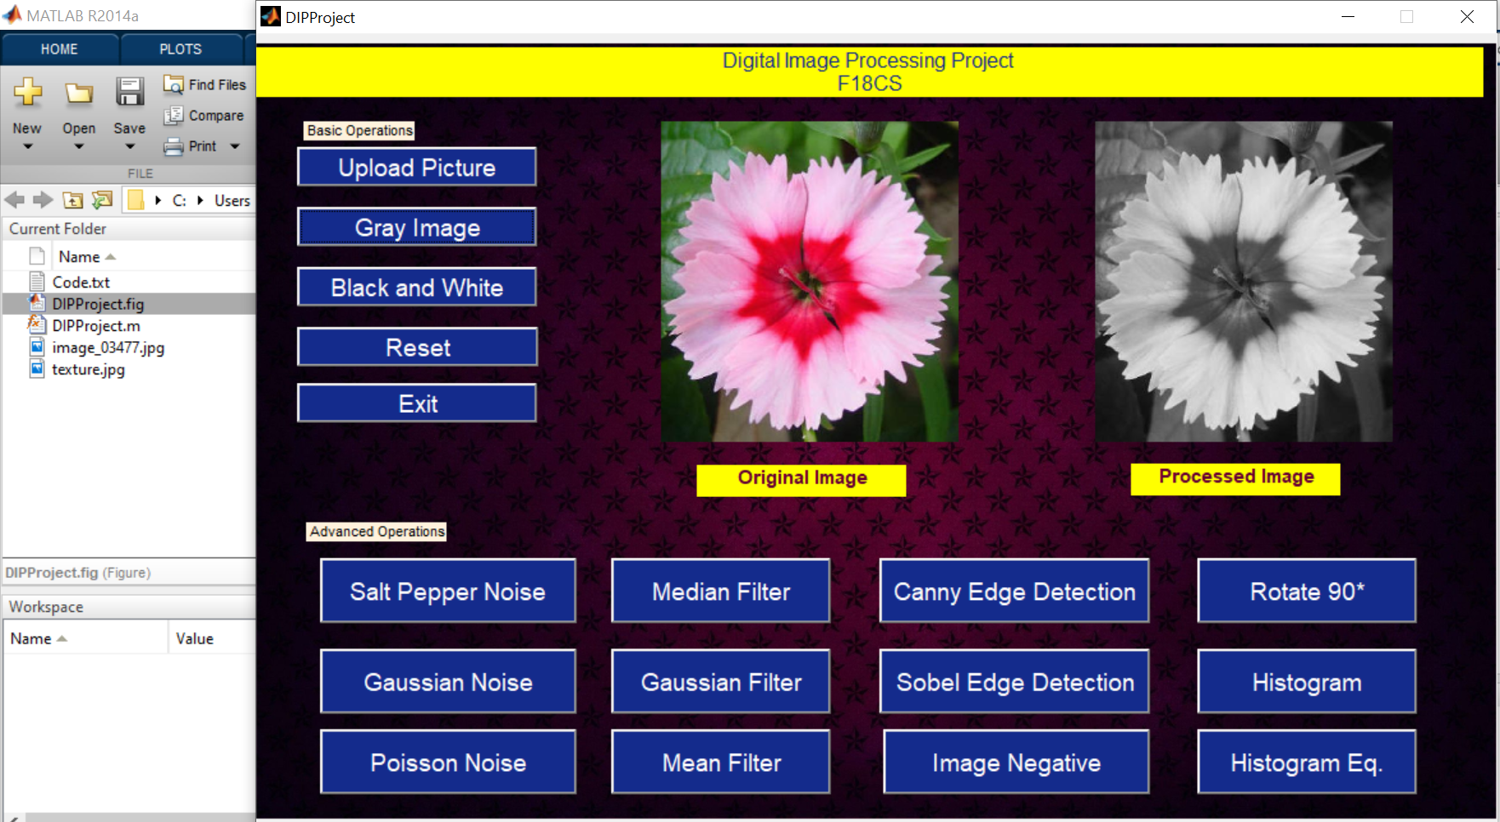
Gray Shade

Slide 4
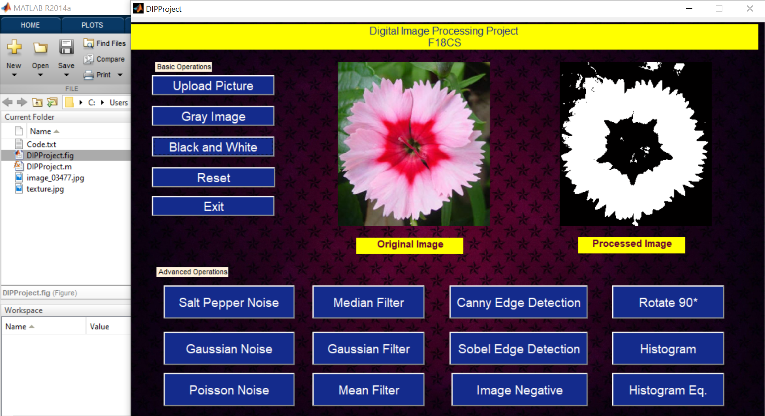
B/W Image

Slide 5
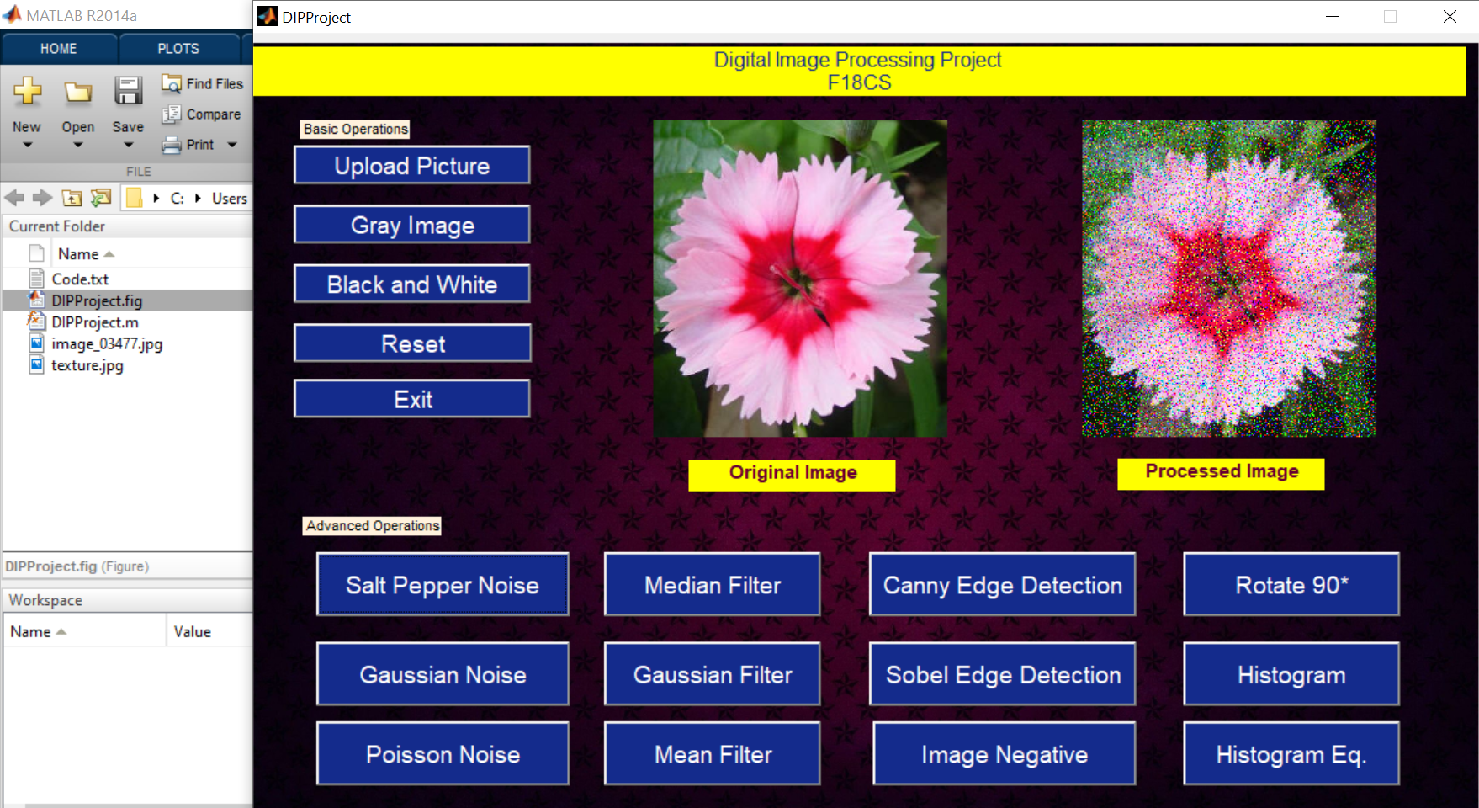
Salt & Pepper Noise

Slide 6

Salt & Pepper Noise + Mean Filter

Slide 7

Salt & Pepper Noise + Median Filter

Slide 8
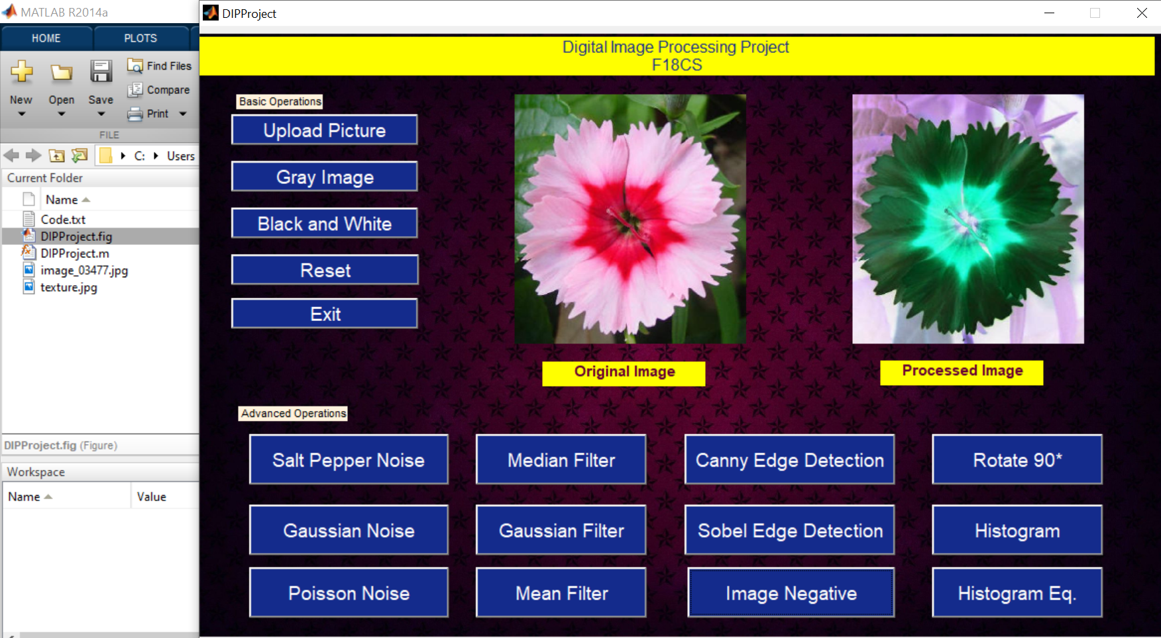
Image Negative

Slide 9

Edge Detection- Canny

Slide 10
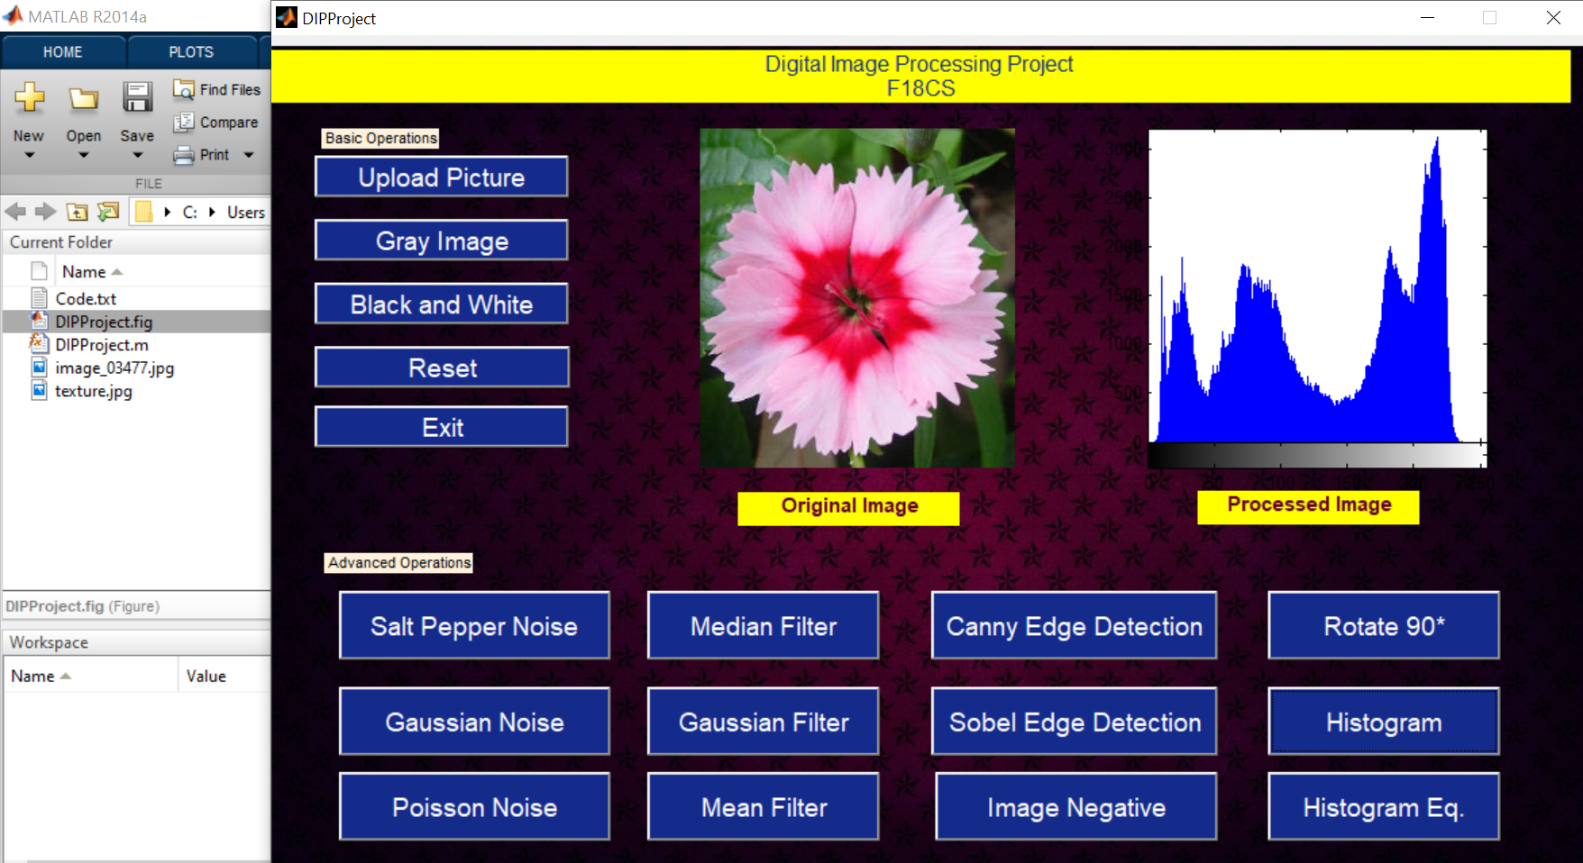
Histogram

Slide 11
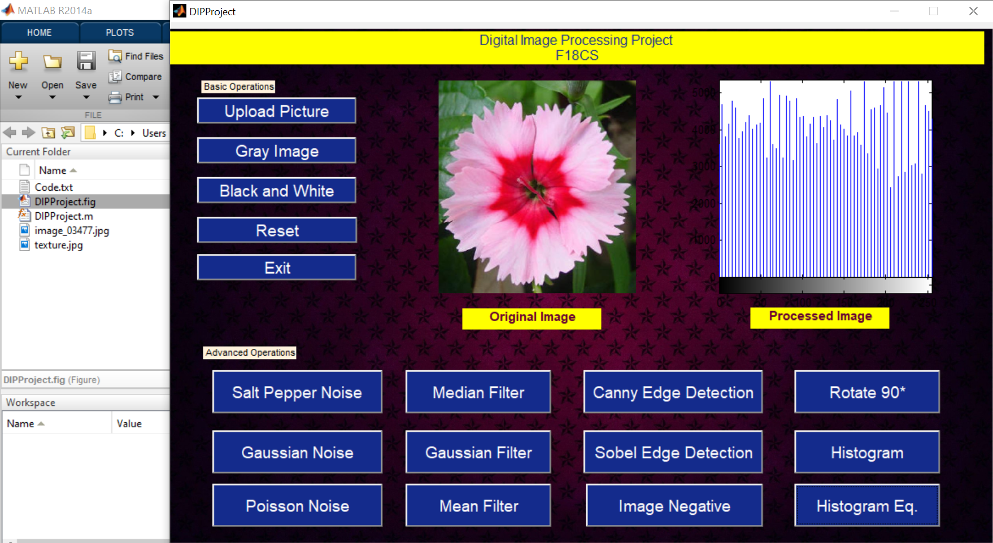
Histogram Equalized

